Slide 1
Power system is monitored at various locations to assess the health of the grid and to identify customers demands
From electric safety viewpoints, the key devices are
Voltage sensors
Current sensors
Frequency sensors

Slide 2
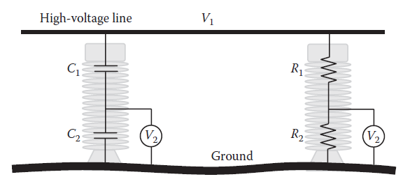
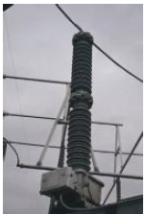
To measure the high voltage of the grid, the voltmeters are used in two main configurations: the voltage divider (VD) and the PT.
Two types of voltage divider circuits

Slide 3

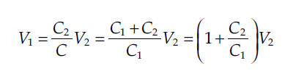
To make this measurement method practical, the current passing through the capacitor must be very small so reasonable current rating capacitors can be used. This can be achieved by using capacitors with very small capacitance.
Also, to have V2 small enough so low dielectric strength voltmeters (or sensors) can be used, C1 must be much smaller than C2.

Slide 4
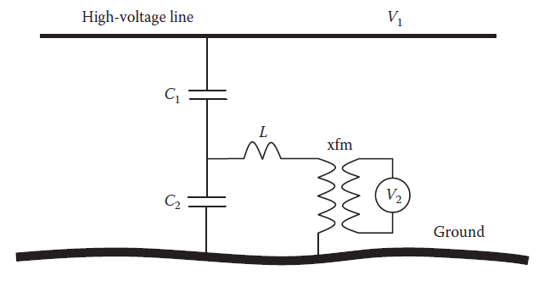
Capacitor voltage transformer.

Slide 5

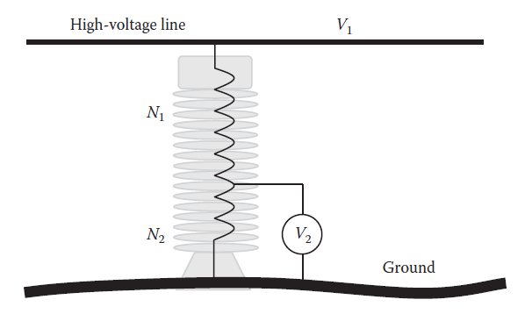

Potential transformer

Slide 6
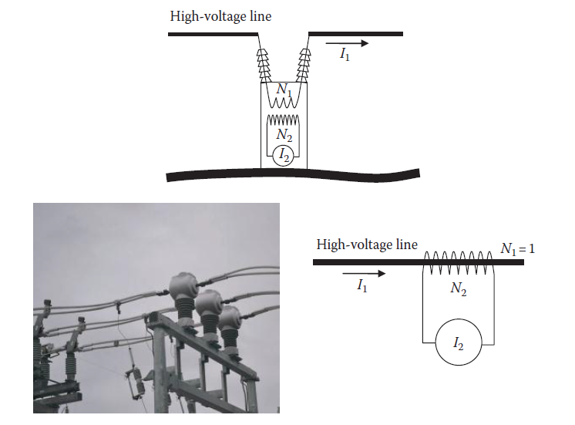
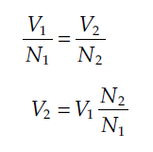
Current Transformer

Slide 7
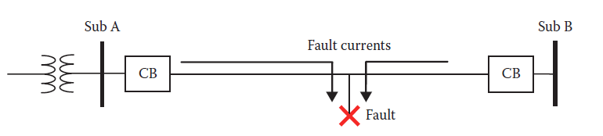
Faulted line with Circuit Breakers
Current Settings and Time Settings of C.Bs

Slide 8
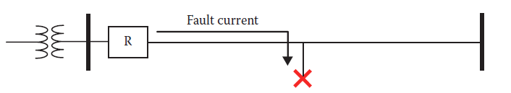
Circuit Reclosers
Most distribution system faults are temporary due to events such as trees brushing power lines, bird and animal intrusion, or dust accumulation on insulators.
When faults occur, utilities assume that the faults are temporary and can be cleared by themselves.
They are used in medium- and low voltage substations as well as distribution feeders.
For single-phase distribution feeders, single-phase reclosers are used.

Slide 9
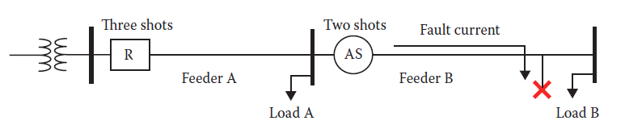
Circuit Sectionalizers
Sectionalizers are programmable switches that can also be manually or remotely operated.
They are not designed to break fault currents or even heavy normal currents.
Instead, they are designed to open when there is no current in the circuit.
This way, there is no need to have elaborate arc extinguish equipments.

Slide 10
Objectives of Grounding system
From the safety point of view:
1. To ensure that a person in the vicinity of grounded facilities is not exposed to excessive charges, and thus is not exposed to the hazards of electric shocks.
2. To provide means to carry electric currents into earth under normal and fault conditions.
3. Under fault conditions, the grounding system must withstand the fault current without being damaged until the overcurrent protection devices isolate the fault.

Slide 11
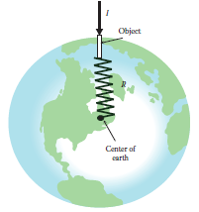
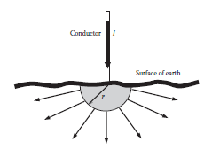
Ground Resistance

Slide 12

